Slide 1
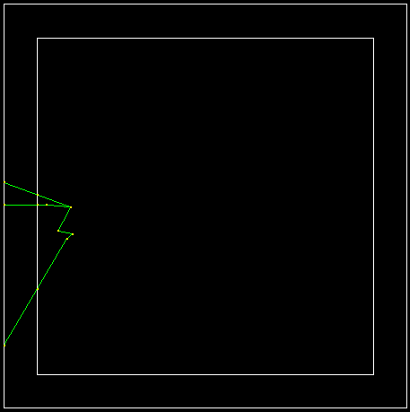
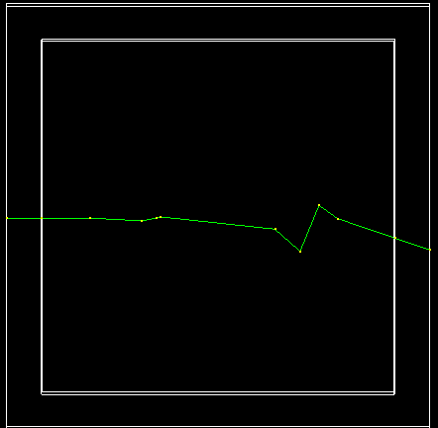





Examples of 2.5 MeV neutron interaction sequence in LArTPC
$n$enters the detector, scatters elastically multiple times and exits the detector.
$n$captured on Ar and performs ⁴⁰Ar(n,n’)⁴⁰Ar process.
$$γ$$
$n$’
⁴⁰Ar(n,n’)⁴⁰Ar vertex
$$n$$
10 cm
10 cm
10 cm
10 cm
Notes:
Here are the lessons learned so far in my summer project. First, a couple of examples of neutron interaction cascade in LArTPC in the relevant energy range for protoDUNE

Slide 2
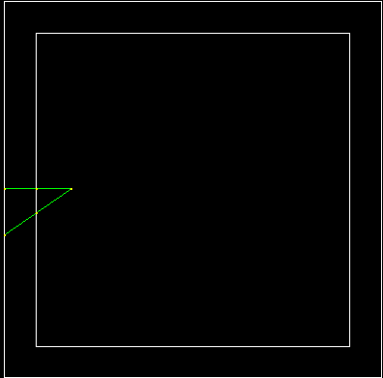
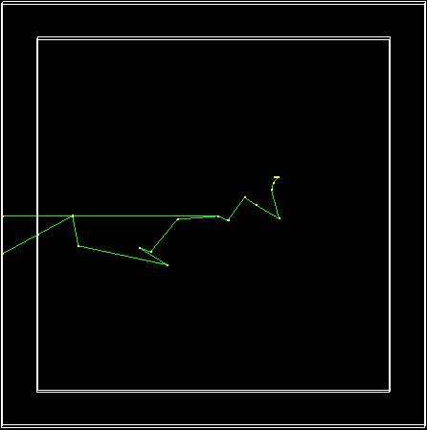
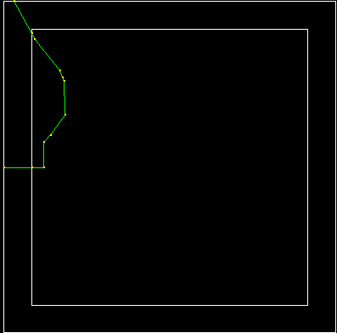


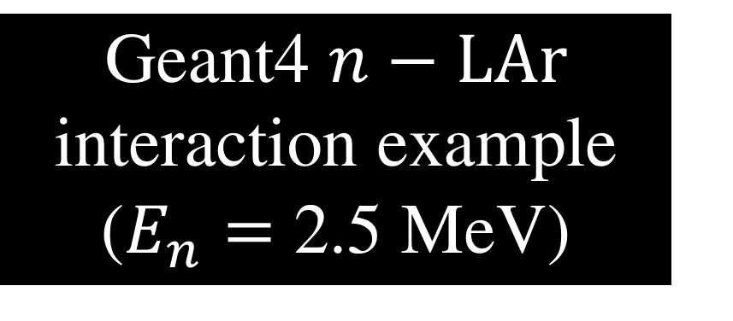





Examples of 2.5 MeV neutron interaction sequence in LArTPC
Geant4 $n−LAr$ interaction example ($E_{n}=$ 2.5 MeV)
$n$enters the detector, scatters elastically and exits the detector.
$n$captured on Ar and performs ⁴⁰Ar(n,n’)⁴⁰Ar process.
$$n$$
$$γ$$
$40Ar(n,n’)40Ar$vertex
$n$enters the detector, scatters elastically multiple times and exits the detector.
$n$’
20 cm
20 cm
20 cm
20 cm
20 cm

Slide 3
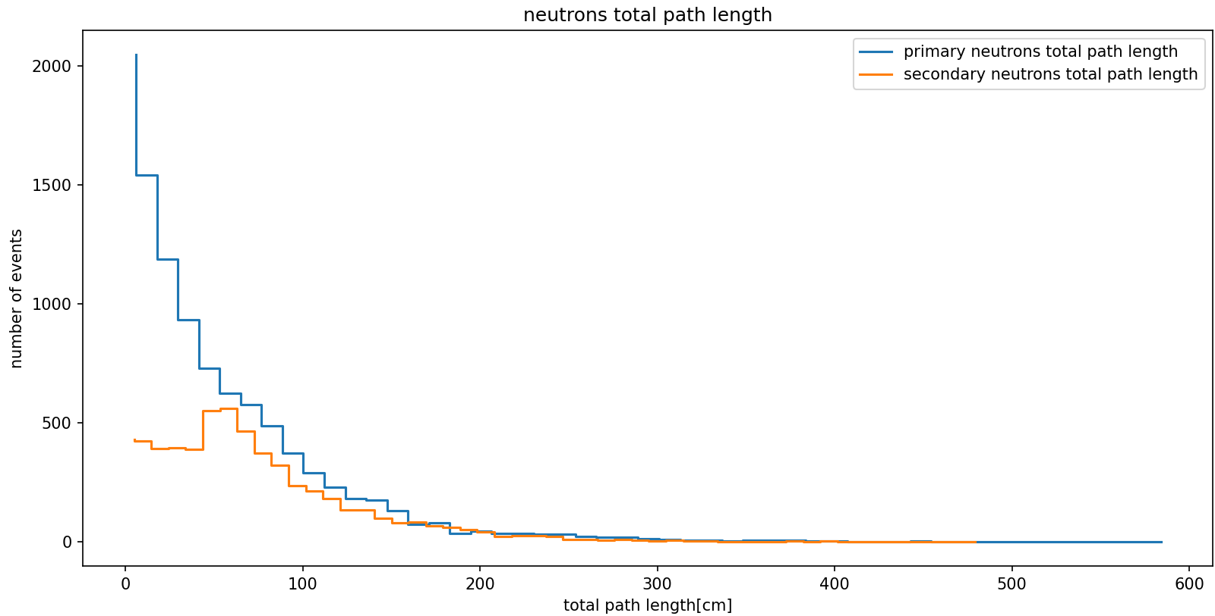

Slide 4
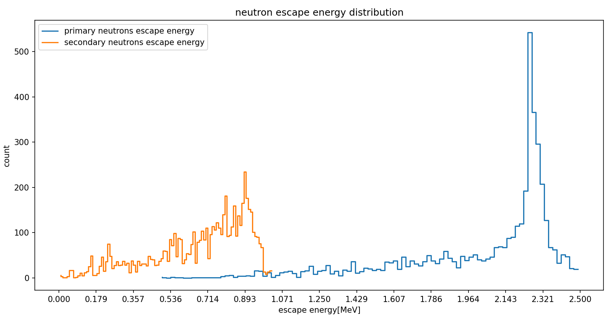


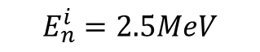
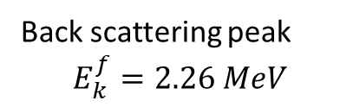
Detector size 1x1x1 meter
Back scattering peak
$$E_{k}^{f}=2.26 MeV$$
LAr
$$E_{n}^{i}=2.5MeV$$
$$E_{n}^{escape}$$
Stopped neutrons have energy = 0
In 58% of events there was an $(n,n’)$process

Slide 5
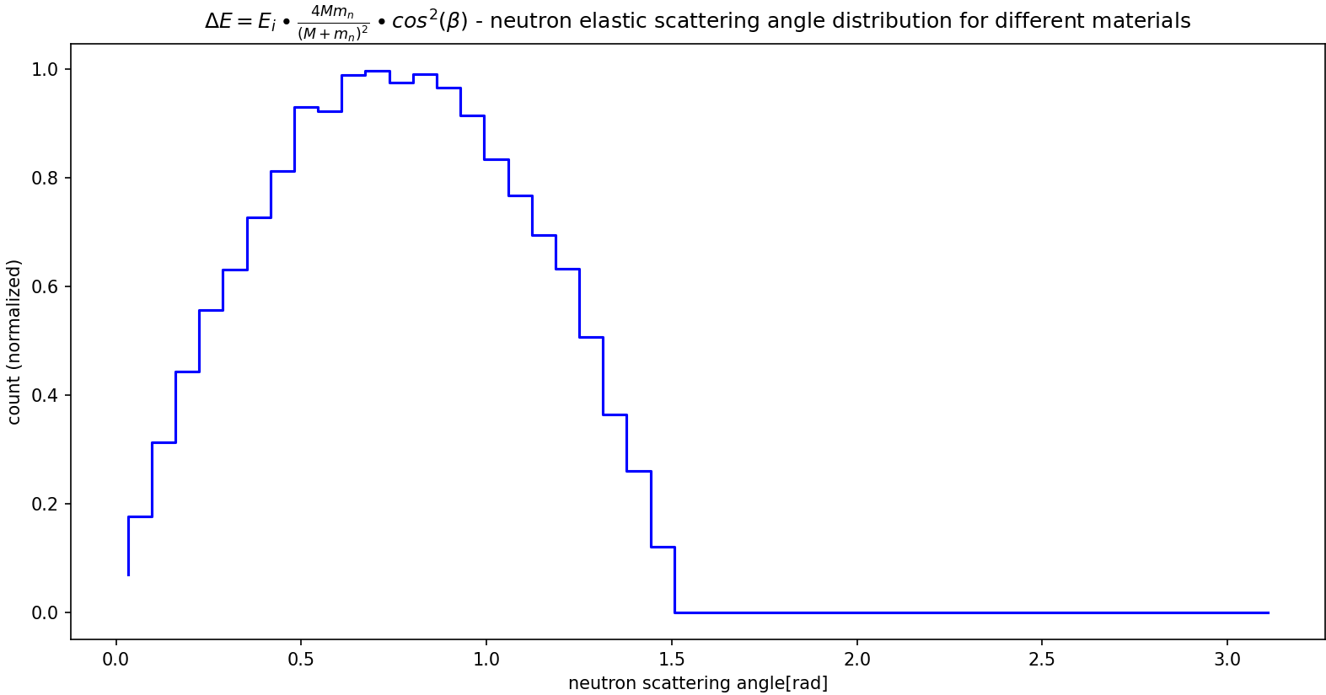
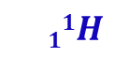
$$11H$$

Slide 6
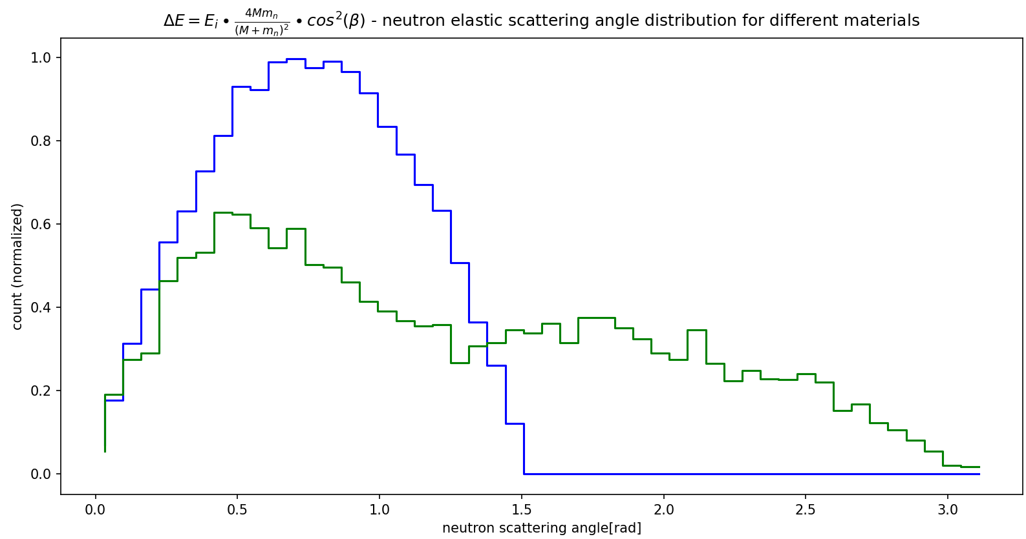
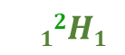
$$11H$$
$$12H1$$

Slide 7
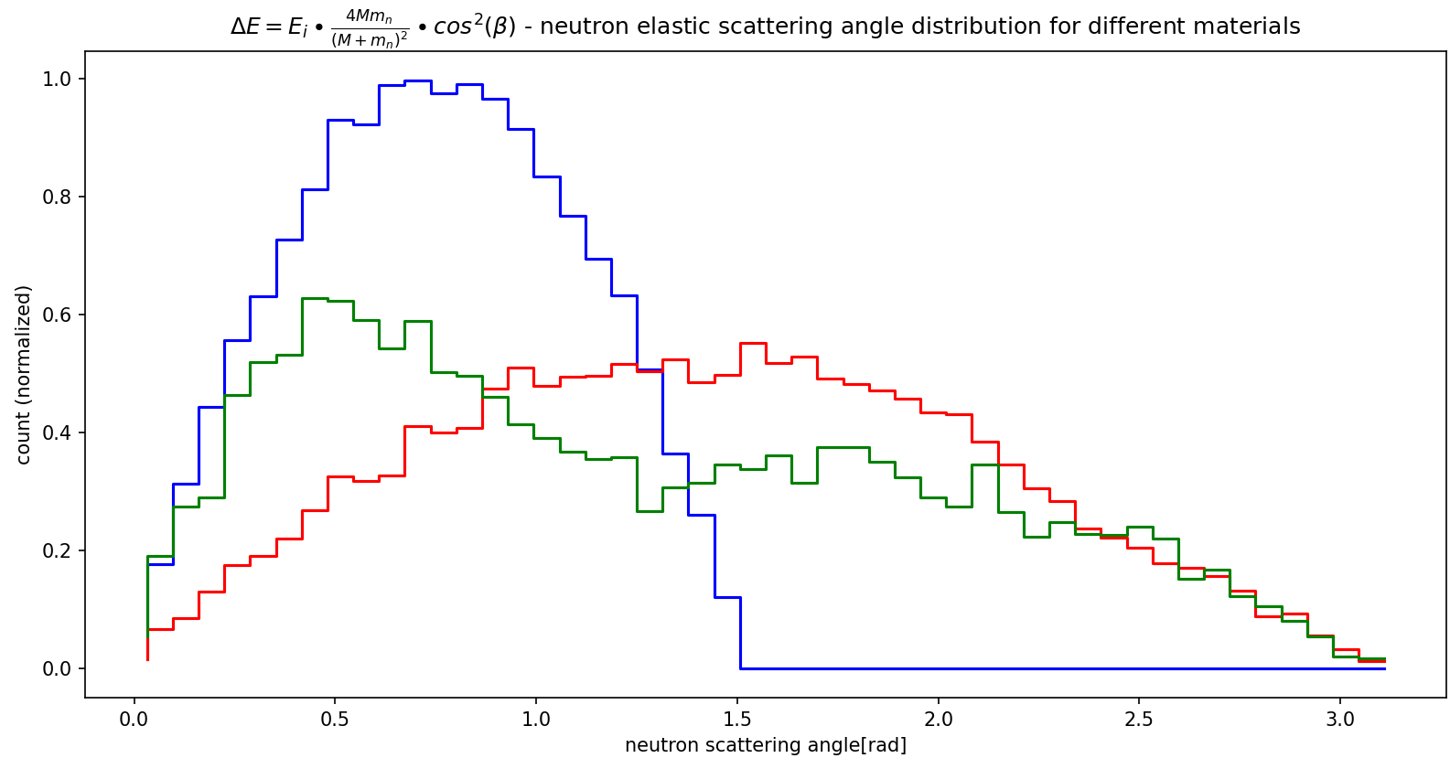
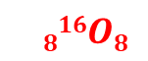
$$11H$$
$$816O8$$
$$12H1$$

Slide 8
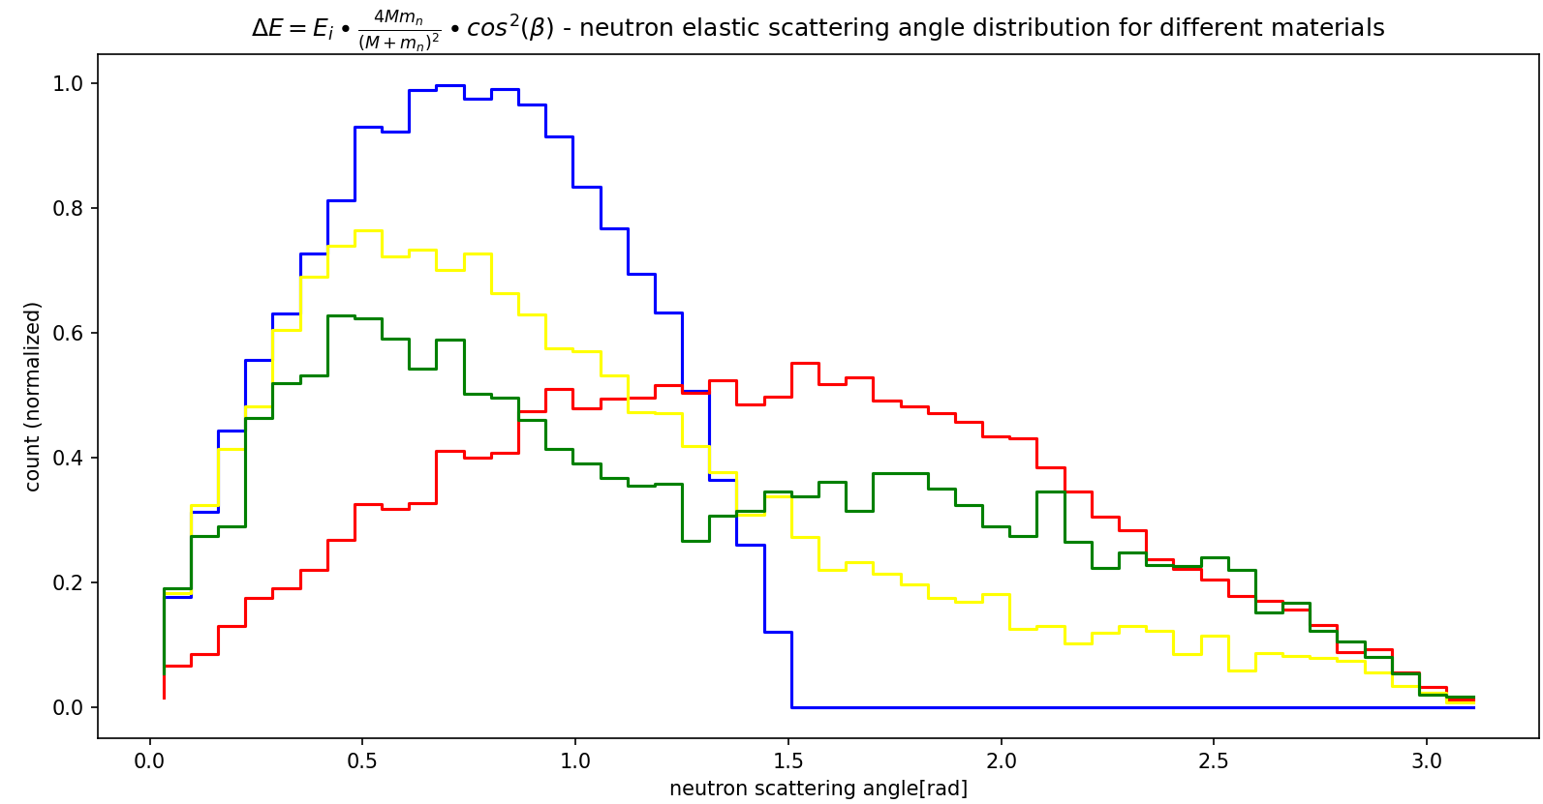
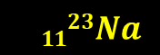
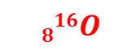

$$11H$$
$$1123Na$$
$$816O$$
$$12H$$

Slide 9
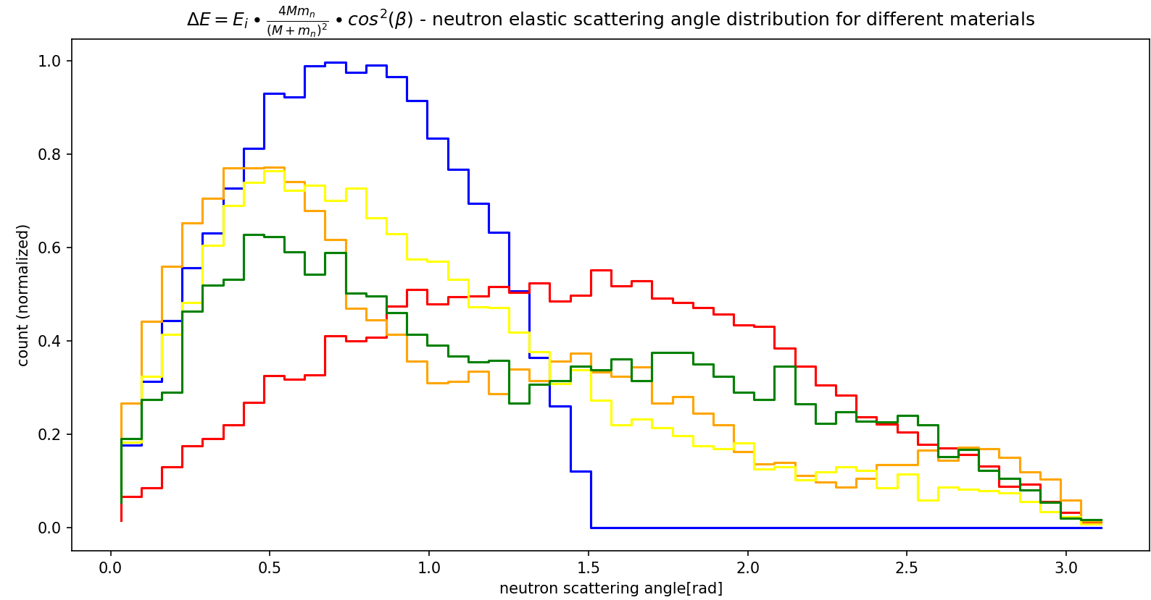
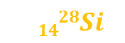

$$11H$$
$$1123Na$$
$$1428Si$$
$$12H1$$
$$816O8$$

Slide 10
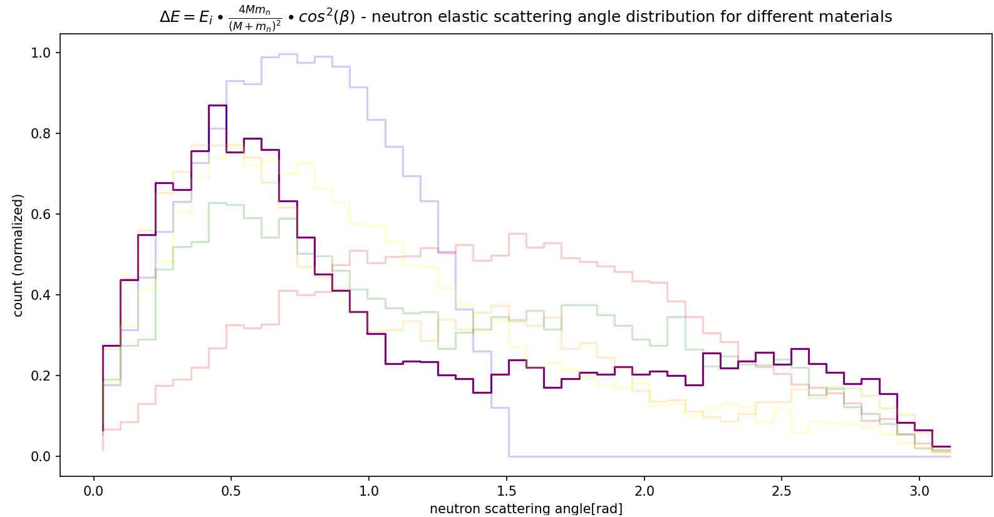
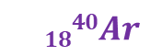
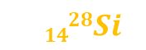
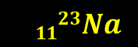
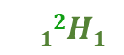
$$11H$$
$$1428Si$$
$$1123Na$$
$$12H1$$
$$816O8$$
$$1840Ar$$

Slide 11
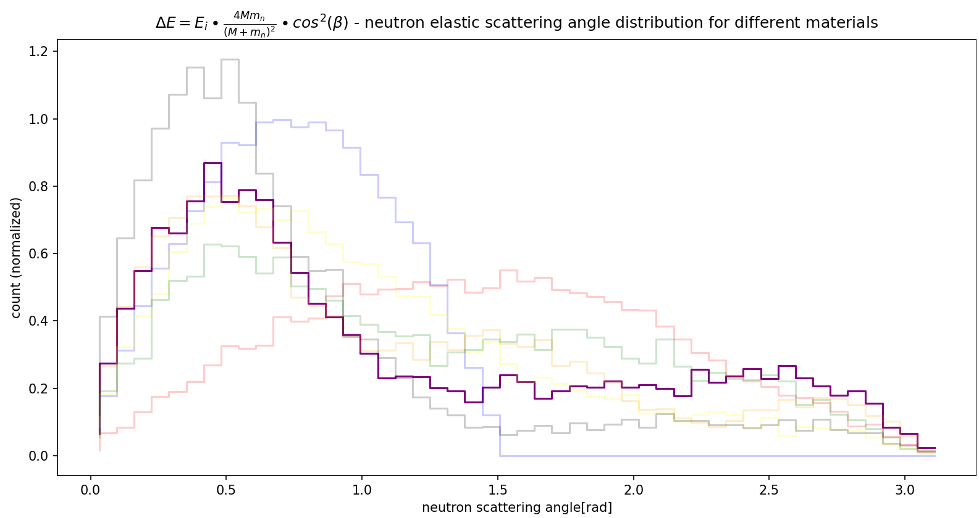
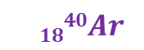
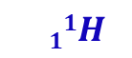


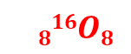
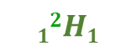
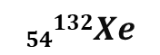
$$54132Xe$$
$$11H$$
$$1428Si$$
$$1123Na$$
$$12H1$$
$$816O8$$
$$1840Ar$$

Slide 12
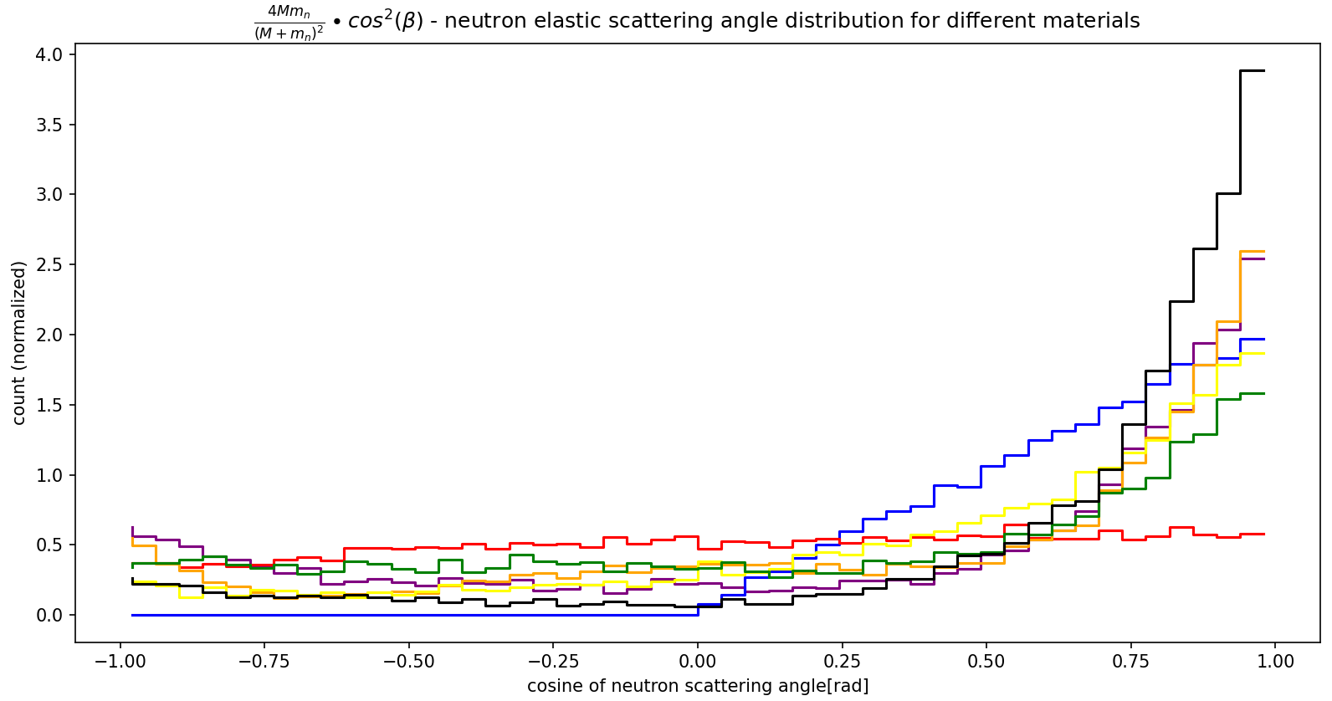
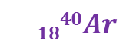
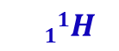
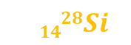
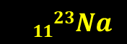
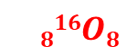
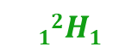
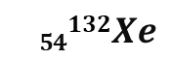
$$54132Xe$$
$$1428Si$$
$$12H1$$
$$11H$$
$$1123Na$$
$$1840Ar$$
$$816O8$$

Slide 13
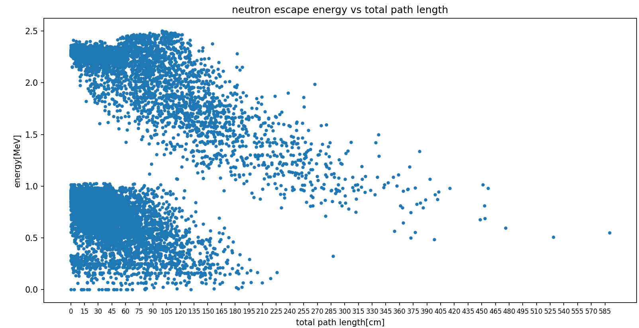
Detector size 1x1x1 meter
$$E_{k}^{i}=2.5MeV$$

Slide 14
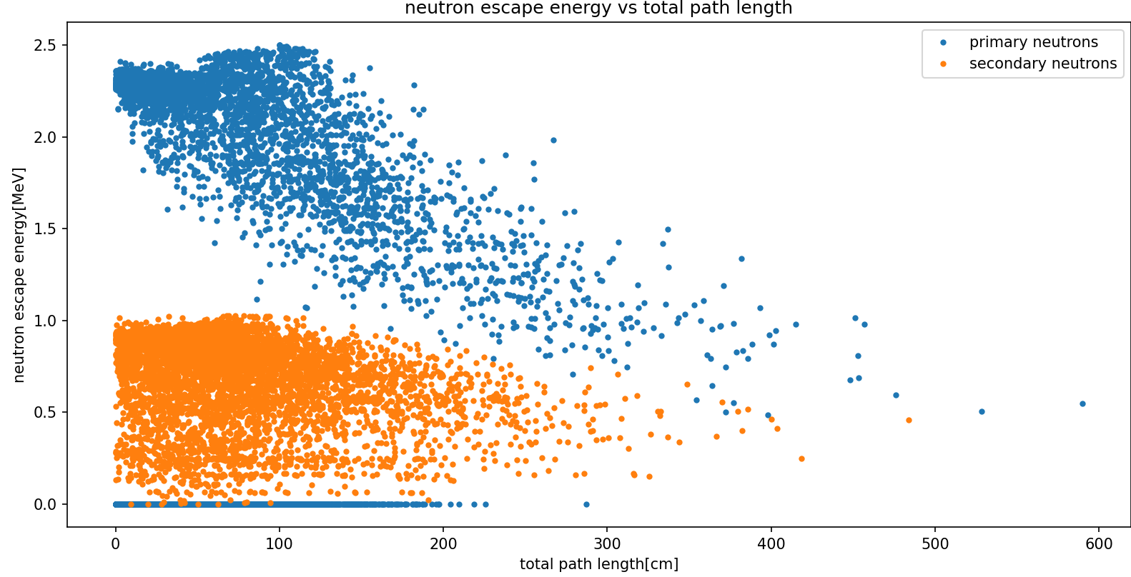
Detector size 1x1x1 meter
$$E_{k}^{i}=2.5MeV$$

Slide 15
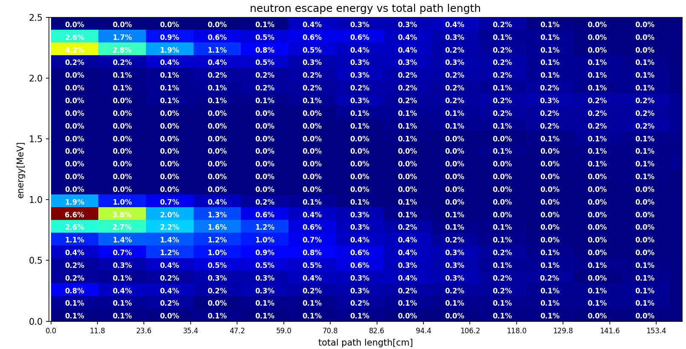
Detector size 1x1x1 meter

Slide 16
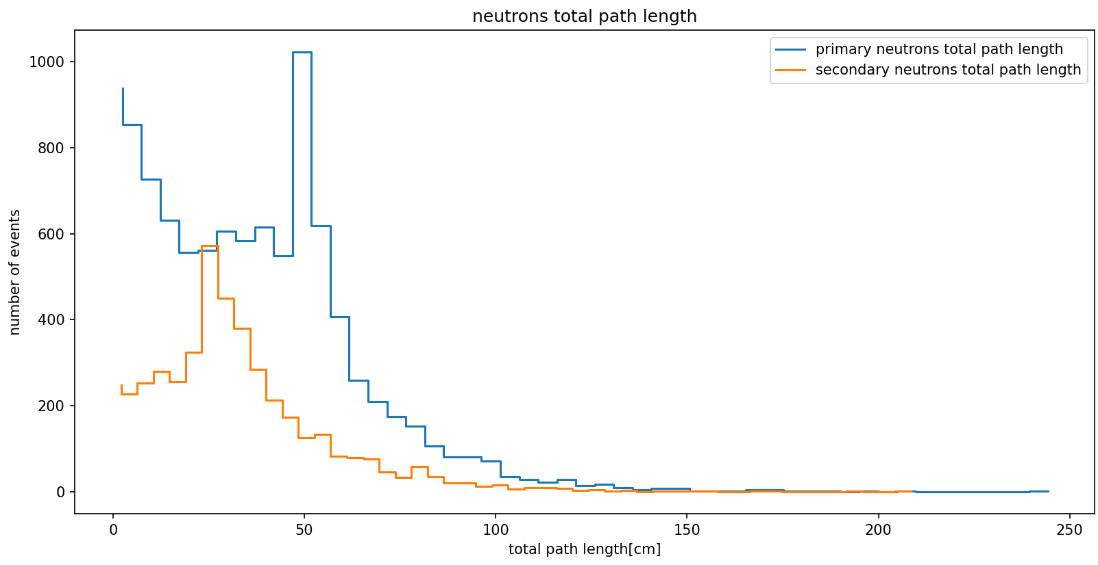
Detector size 0.5x0.5x0.5 meter
$$E_{k}^{i}=2.5MeV$$

Slide 17
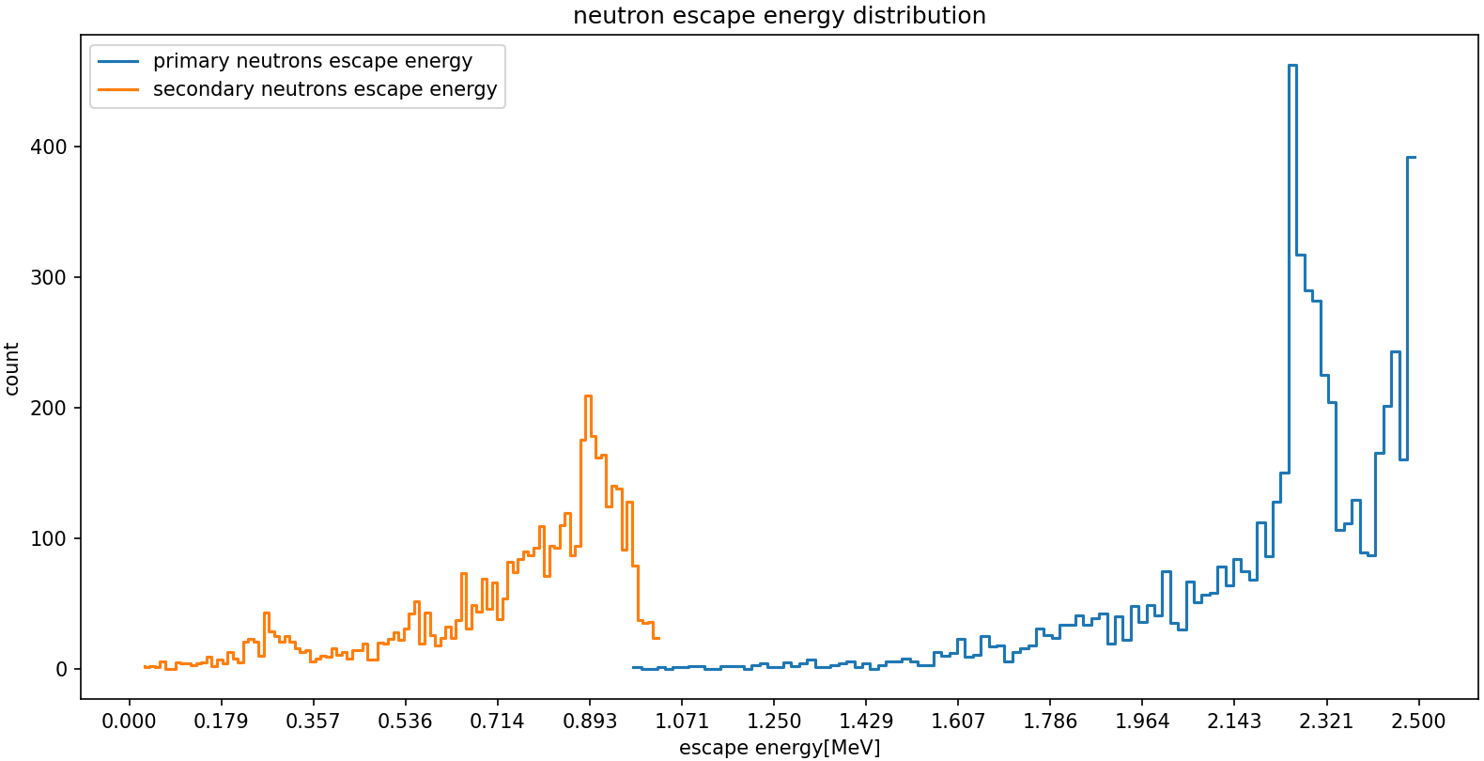

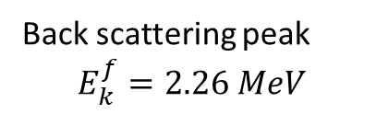
Detector size 0.5x0.5x0.5 meter
Back scattering peak
$$E_{k}^{f}=2.26 MeV$$
0 interaction neutrons
$$E_{k}^{i}=2.5MeV$$
Stopped neutrons have energy = 0
In 45% of events there was an $(n,n’)$process

Slide 18
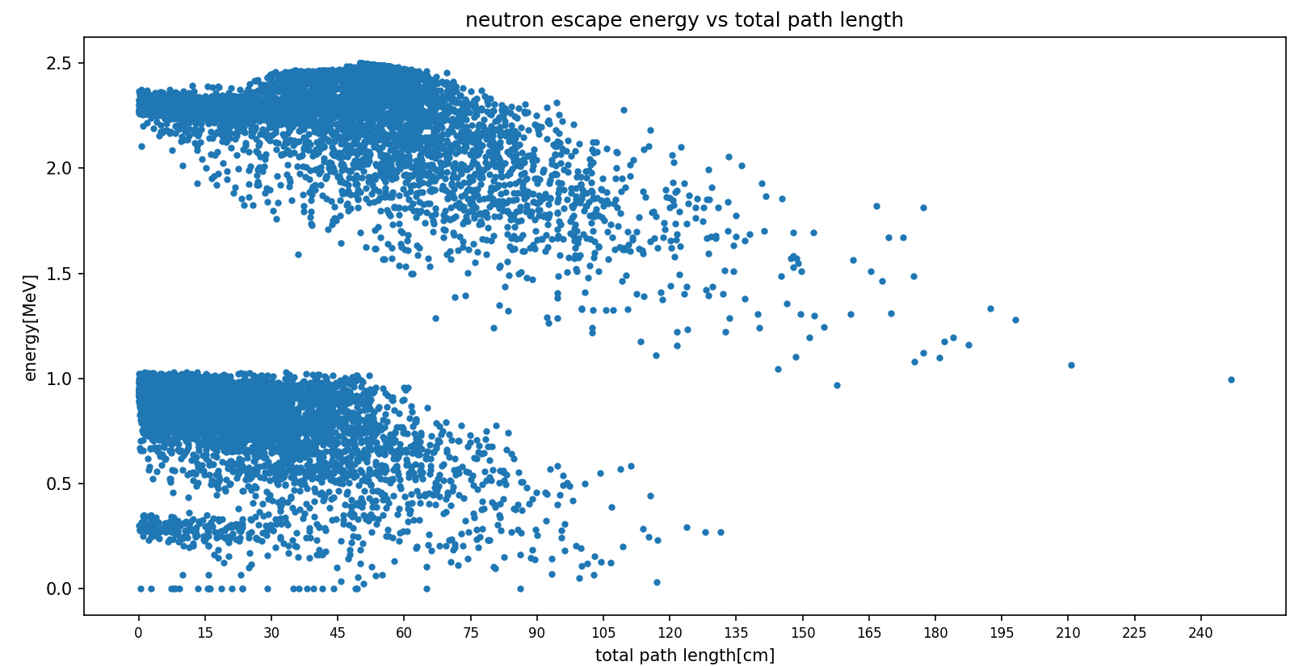
Detector size 0.5x0.5x0.5 meter
$$E_{k}^{i}=2.5MeV$$

Slide 19
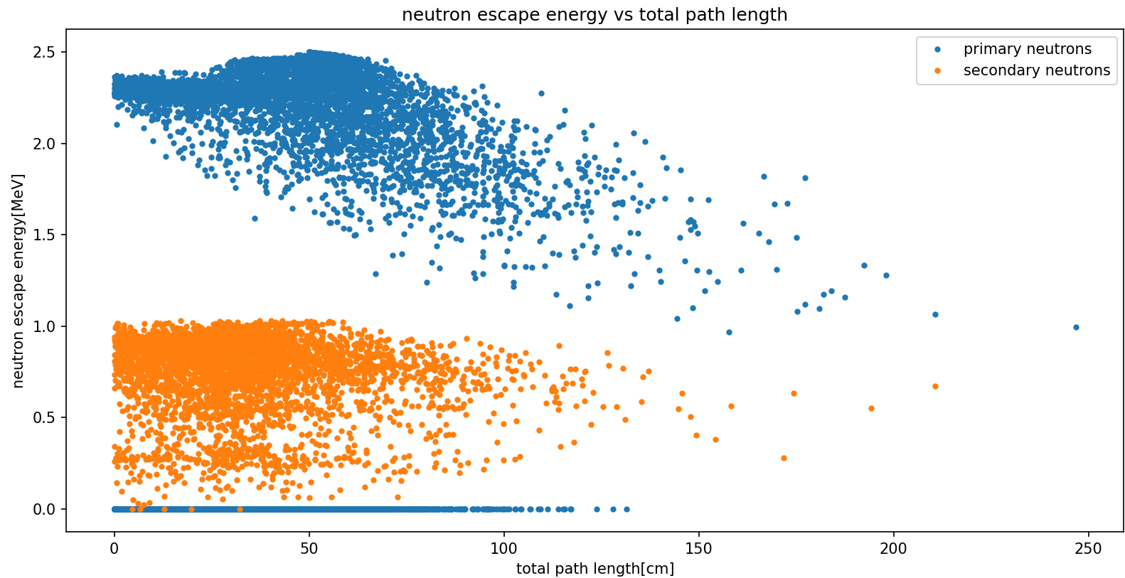
Detector size 0.5x0.5x0.5 meter
$$E_{k}^{i}=2.5MeV$$

Slide 20
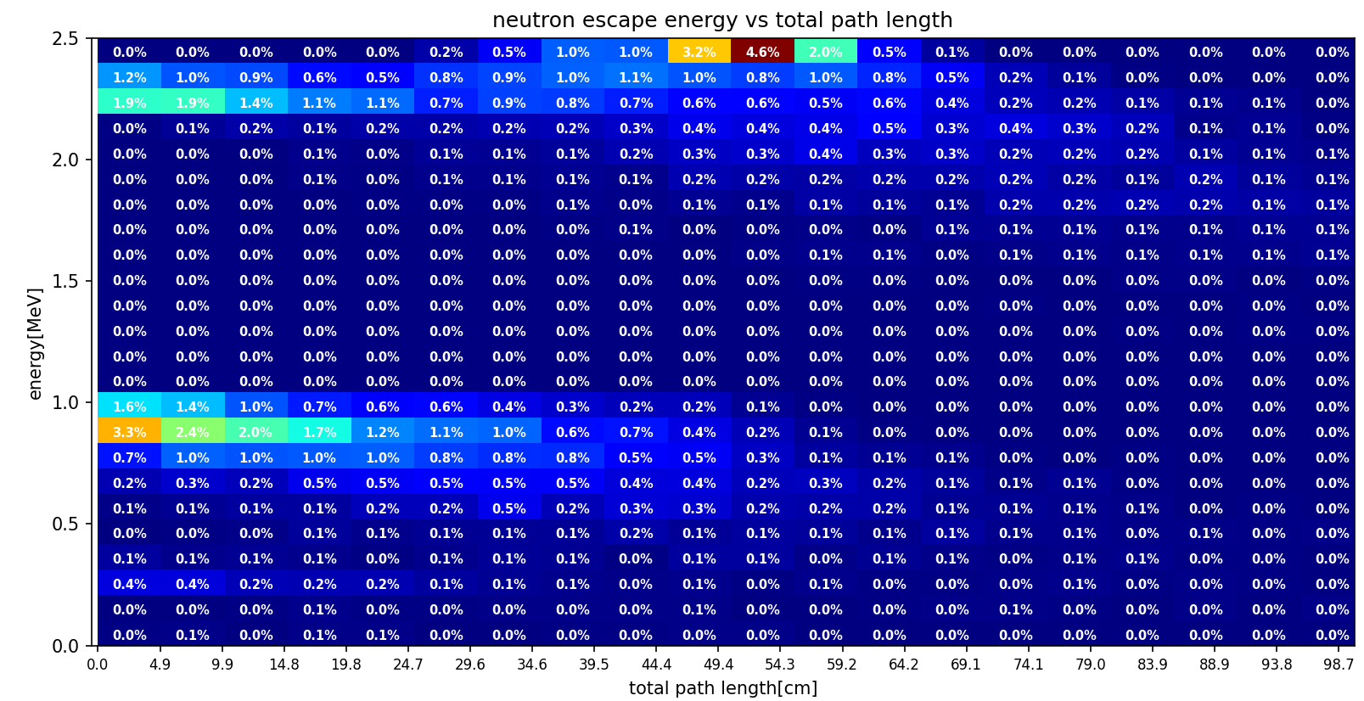
Detector size 0.5x0.5x0.5 meter

Slide 21
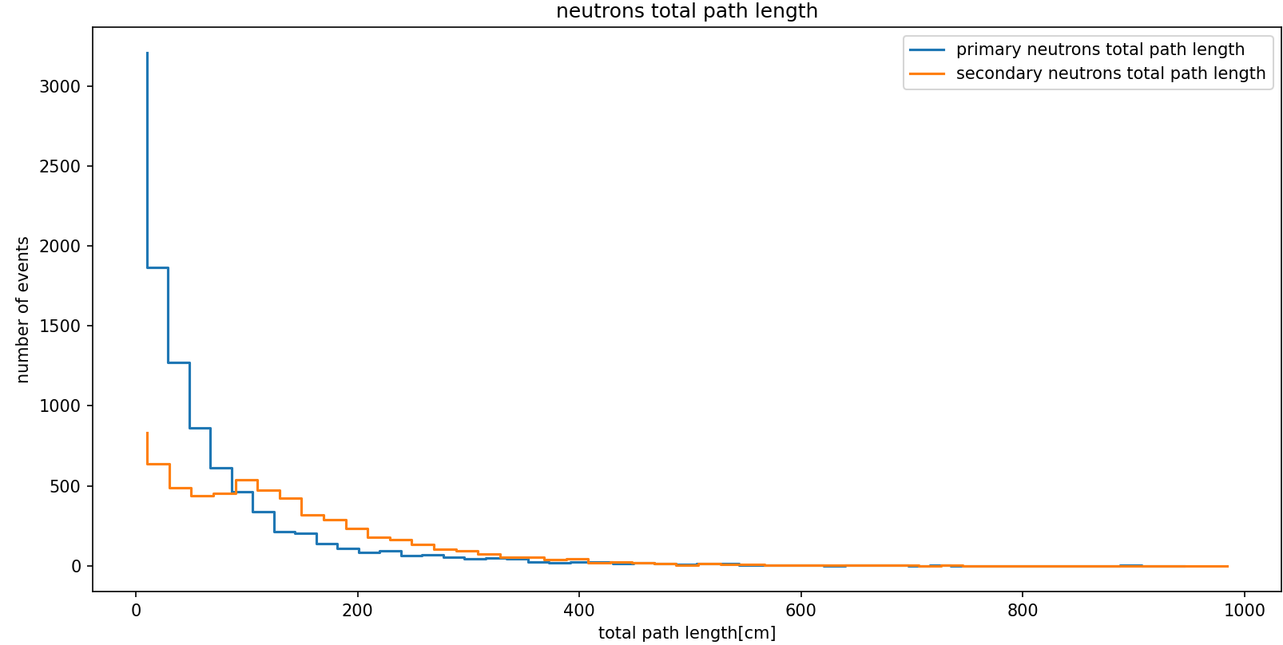
Detector size 1x2x2 meter
(thickness = 1m)

Slide 22


Detector size 1x2x2 meter
(thickness = 1m)
Back scattering peak
$$E_{k}^{f}=2.26 MeV$$
$$E_{k}^{i}=2.5MeV$$
Stopped neutrons have energy = 0
In 62% of events there was an $(n,n’)$process

Slide 23

Detector size 1x2x2 meter
(thickness = 1m)
$$E_{k}^{i}=2.5MeV$$

Slide 24

Detector size 1x2x2 meter
(thickness = 1m)
$$E_{k}^{i}=2.5MeV$$

Slide 25

Only for primary neutrons (didn’t perform (n,n’))
Detector size 1x2x2 meter
(thickness = 1m)

Slide 26

Only for primary neutrons (didn’t perform (n,n’))

Slide 27

Only for primary neutrons (didn’t perform (n,n’))

Slide 28


Slide 29


Slide 30



$$E_{k}^{i}=2.5MeV$$
0 interaction neutrons
100k events
Back scattering peak
$$E_{k}^{f}=2.26 MeV$$

Slide 31

100k events

Slide 32



Distribution does not include secondary neutrons
Primary neutrons, $E_{n}^{i}=2.5MeV$
$$λ=11.97±0.06 cm$$
$$f\left(x\right)=A∙e^{−0.0836x}$$

Slide 33



Distribution also includes secondary neutrons
$$E_{n}^{i}=2.5MeV$$
pvalue=0.79
$$f\left(x\right)=A∙e^{−0.0677x}$$
$$λ=14.8±0.2 cm$$

Slide 34






Only for primary neutrons (didn’t perform (n,n’))
Of primary neutrons with $E_{k}^{i}=2.5 MeV$
$$f\left(x\right)=0.66x$$
No data here since this graph only looks at primary neutrons (trackID =1), meaning only neutrons which did not perform (n,n’), also really slow neutrons(low kinetic energy) can be captured by nuclei.
$$v=0.07∙c$$
No data here since neutron speed is capped at initial neutron speed with $E_{k}^{i}=2.5 MeV$
$$v=c$$

Slide 35




$$E_{k}^{i}=2.5MeV$$
Also includes secondary neutrons (n’)
$$f\left(x\right)=0.66x$$
$$v=0.07∙c$$
$$v=c$$

Slide 36

No protons exit the detector, though some are created in (n,p) process with Argon 36

Slide 37


Slide 38


Slide 39



1.46 MeV
⁴⁰Ar 2+ -> 0+
Minimum photon energy = 218 eV
⁴¹K created by ⁴¹Ar $β^{−}$decay
⁴¹Ar created by nCapture on ⁴⁰Ar
e-e+ created by pair production first and then annihilate to create gamma rays
659.9 keV
⁴⁰Ar 0+ band 2 -> 2+ band 1
^{1.29 MeV}
⁴¹K 7/2- -> 3/2 +
$e^{−}e^{+}→$2$γ$

Slide 40




660 keV
⁴⁰Ar 0+ $→$2+
1.46 MeV
⁴⁰Ar 2+ $→$ 0+
^{1.29 MeV}
⁴¹K 7/2- -> 3/2 +
$e^{−}e^{+}→$2$γ$
Example gamma production by n-LAr:
⁴⁰Ar + n $→$ ⁴¹Ar $→$ $β^{−}$decay $→$ ^{41m}K $→$ ⁴¹K + $γ$

Slide 41


Slide 42


Slide 43


Slide 44





$n′$
Primary $n$
LAr
$secondary γ$
$$\left(n,n^{′}\right)vertex$$

Slide 45



Slide 46


Slide 47



Slide 48


Slide 49


Slide 50



Creus et al. , JINST 10 (2015)
Consequence -
In the paper they neglect inelastic scatters because they use elastic kinematics in order to calculate nucleus recoil, and thus in 17% of events they have an error in their calculations.
Our geant4 simulation-
Emulating the LAr cell size(roughly)
neutron
50 mm
?

Slide 51




My geant4 simulator
Article experimental setup
$$θ$$
LAr cell
5’’ liquid scintillator
in the experiment there is also a 1.5mm aluminium layer around the sensitive volume of LAr, but the effect on the neutrons is minimal(sub percent)
Also, in reality the beam is collimated into 0.2% 4pi steradians which gives an effective surface area of $0.013 [cm^{2}]$ of neutrons hitting the LAr, and in my simulator I use a pencil beam (0 width)

Slide 52


Slide 53



Article experimental setup
Nucleus $E_{recoil}$ dist.
$$θ={25}^{∘}$$

Slide 54






$$0^{∘} scatter$$
$${90}^{∘} scatter$$

Slide 55




$${25}^{∘} scatter$$
$$θ$$

Slide 56

Liquid scintillator placed at ${25}^{∘}$ angle relative to LAr cell,
Showing the neutron scattering angle distribution within the active volume of the cell without external scatters

Slide 57


Comparison of my simplified simulator time of flight distribution for different event types vs Creus et al. , JINST 10 (2015)
General trend is the same.

Slide 58

After time of flight cut - $42 \left[ns\right]< time < 49 [ns]$

Slide 60


Slide 61





Slide 62

This work (simplified geometry)
Creus et al. , JINST 10 (2015)
Single elastic
Multiple elastic
Single elastic and external

Slide 63

https://www.sciencedirect.com/science/article/pii/S0927650516302341

Slide 64
In order to make sure we understand how to properly set the required parameters for scintillation light in geant4, we first want to make some sanity checks.
First and foremost, we want to see that the distribution of the amount of scintillation photons created matches the parameter we set for the SCINTILLATIONYIELD.
Doing this we run into a problem – we don’t seem to get the right amount of photons.
The following slides explain why that is

Slide 65


When setting the SCINTILLATIONYIELD of a material in geant4, geant takes into account the birks constant when calculating how many scintillation photons to produce in an event, even for electrons. This means you will see fewer scintillation photons than your input parameter.
Even if you set birks constant = 0, the physics package overrides and sets the LAr birks constant = 0.032 mm/MeV
This tracks according to the data we gathered – using the average path length of the primary electron in the detector(with ${E_{k}}_{i}=1MeV)$, we can calculate the light yield attenuation assuming birks constant = 0.032 using:
$attenuation=\frac{1}{1+0.032∙avg.path length}=1.007−1.009$
if you can the amount of scintillation photons per event, you can deduce the attenuation of the light yield by $\frac{51000}{num of scint photons}$
This comes out to be around 1.012 when checking each photon individually by its track and 1.008 using the process vector->GetNumPhotons method.

Slide 66


Using processVector->getNumPhotons
Checking each track individually

Slide 67

Finally, when setting birks constant to a really small number, but not 0, so that the physics package does not override it, you see a distribution centered around 51000 photons per event as expected:

Slide 68

Moving on, we want to perform extra sanity checks. We start by firing a 1 MeV electron directly in the center of our LAr cylinder.
Firstly, the emitted scintillation photons’ wavelength – this distribution matches the parameters we set – centered around 128nm wavelength for the emission spectra.

Slide 69

Next, looking at the emission timing of the scintillation photons, with fast component set to 7ns and slow component set to 1500ns:

Slide 70



Next, the scintillation photons’ angular distribution, separated to spherical angles $θ$and $φ$.

Slide 71

And finally, looking at the positions in which the scintillation photons were created and seeing they roughly match the track of the primary electron:

Slide 72



Now we can safely move on to try and fully recreate the findings of Creus et al.
We first try to emulate PMTS and coincidence between them in the following way – we ask how many photons reached each base of the LAr cylinder (in their research there are 2 PMTS surrounding each base), and in order to take into account the QE of the TPB and PMT we roll a random number in a uniform distribution in the range (0,1) and if it is < 0.25 we say the photon was absorbed inside the pmt.
In order to ask if there was coincidence between the PMTs, we look at the time difference of photons reaching the top PMT and the bottom PMT, and if in an event we get a time difference that is smaller than $\frac{c}{n∗h}$ (where c is the speed of light, n is the refractive index of LAr , and h is the height of the cylinder), we say that there is coincidence in the event.
The following plots are for a primary electron:

Slide 73




The following plots are for a primary proton:
The rest of the plots are pretty similar to the electron plots. The main difference is in the positions in which the scintillation photons are created – a proton primary deposits most of its energy over a very short distance relative to the electron, and so all scintillation photons are created very close to the center of the LAr cylinder (that is also the reason the scintillation yield is smaller for a proton relative to an electron)

Slide 74
The plan now is to go back and recreate table 4 from the swiss paper.
This requires calculating the light yield from nuclear recoils and from electron recoils at 6 different energies.
For neutrons the light yield is calculated for the 6 different scattering angles in the time of flight cut (in order to isolate elastic events). The PMT QE is roughly 15% according to Creus et al. , and the reflector used “is nearly a 100% diffuse Lambertian reflector” [The ArDM Collaboration et al 2009 JINST 4 P06001]. We will set the reflectivity between 97-98%.
In order to calculate the light yield for the electron recoils, we will first make a calibration graph. We will use the 60keV photopeak from 241Am, 122 keV photopeak from 57Co, and the 341keV, 478keV and 1061keV Compton edges from 22Na, 137Cs and 22Na respectively.

Slide 75

Calculating Compton edges for 22Na, 137Cs gamma rays:
In a Compton scattering process, an incident photon collides with an electron in a material. The amount of energy exchanged varies with angle, and is given by the formula:
$$E^{′}=\frac{E}{1+\frac{E}{m_{e}c^{2}(1−\cos\left(θ\right))}}$$
E is the energy of the incident photon
E’ is the energy of the outgoing photon
$θ$ is the angle of deflection for the photon.
The energy of the electron is then calculated by E – E’, and a Compton edge is formed at a deflection angle of 180 degrees.
Thus, $E_{ce}=E −E^{′}\left({180}^{∘}\right)=E (1 −\frac{1}{1+\frac{2E}{m_{e}c^{2}}})$
Plugging the numbers for gamma rays with energies 511keV, 662keV and 1274keV we get Compton edges :
Compton Edge (511keV) = $\frac{2}{3}E=341keV$
Compton Edge (662keV) = $0.72E=478keV$
Compton Edge(1274keV) = $0.833E=1061keV$

Slide 76

This is an example of a scintillation yield histogram for a 60keV gamma ray.
We now want to be able to extract the light yield from this histogram. In order to do that we average the two PMTs and then fit a
Gaussian around the photopeak to find the mean and the std.

Slide 77


Slide 78

If we were to look at the energy deposit of the photon, we would expect to see a sharp peak at the photopeak energy , like this:

Slide 79

Photopeak
Compton Edge
With 122keV photon we first see a Compton edge on the left, and then a photopeak on the right.

Slide 80



At higher photon energies we can no longer see a photopeak, since the Compton scatter integral is considerably larger than the photopeak.

Slide 81


And so in order to extract the light yield, we have to use the Compton Edge instead of a photopeak.
Looking at the scintillation yield, after the peak we see a soft drop off, whereas if we were to look at the energy deposit we see a sharper drop off which is after the Compton Edge energy -
Sharper drop - off
This is because the number of scintillation photons created by a specific energy deposit varies around the mean. The actual scintillation yield is located half way in the drop off after the peak in the scintillation histogram.

Slide 82

This is exemplified by the following graph, which shows that the convolution of a step function(Compton Edge) with a Gaussian(number of scintillation photons created) gives a function whose y value is half the peak of the gaussian at the x coordinate of the step function edge/gaussian peak.

Slide 83












22$Na$
$$1061 keV$$
$$y=3.18x −32.99$$
1$37Cs$
$$478 keV$$
22$Na$
$$341 keV$$
$$57Co$$
$$122 keV$$
24$1Am$
$$60 keV$$

Slide 84






$$1061 keV$$
22$Na$
$$y=3.07 \left(±0.07\right) x$$
1$37Cs$
$$478 keV$$
22$Na$
$$341 keV$$
$$57Co$$
$$122 keV$$
24$1Am$
$$60 keV$$

Slide 85



We now need to calculate the scintillation yield from nuclear recoils , using histograms such as this –
Looking only at events that are in the time-of-flight cut between 42 and 49 ns, that were detected in the liquid scintillator, located at a ${25}^{∘}$ angle relative to the LAr cell.

Slide 86

We do this by fitting a gaussian to the area around the peak of the graph, like so:

Slide 87


Now, in order to reconstruct Table 3 from Creus et al. , we use the fit we got of the electron recoil energy vs. scintillation yield, to calculate the scintillation yield from electron recoils at the 6 nuclear recoil energies corresponding to the 6 neutron scattering angles.
For example, $L_{eff}\left({25}^{∘}\right)=\frac{L_{nr}\left(T_{nr}\right)}{L_{er}(T_{er})}=\frac{L_{nr}\left(11.5keV\right)}{L_{er}(11.5keV)}±\sqrt{{\left(\frac{ΔL_{nr}}{L_{er}}\right)}^{2}+{\left(\frac{L_{nr}ΔL_{er}}{L_{er}^{2}}\right)}^{2}}$
Assuming a line equation of the form $y = ax+b$for the electron recoil graph,
$L_{er}=a∙11.5keV+b$ , where a and b are obtained from the fit
$ΔL_{er}=da∙11.5keV+db$ , where da and db are obtained from the fit
$L_{nr}=μ$ and is obtained from the gaussian fit to the scintillation yield histogram from nuclear recoils
$ΔL_{nr}=σ$ and is obtained from the gaussian fit to the scintillation yield histogram from nuclear recoils
Using these, we get $L_{eff}\left({25}^{∘}\right)=2.71±5.97$
$L_{eff}\left({30}^{∘}\right)=0.70±0.38$

Slide 88


$$L_{eff}\left({25}^{∘}\right)=\frac{L_{nr}\left(T_{nr}\right)}{L_{er}(T_{er})}=\frac{L_{nr}\left(11.5keV\right)}{L_{er}(60keV)}∙\frac{60}{T_{nr}}±60∙\sqrt{{\left(\frac{ΔL_{nr}}{L_{er}∙T_{nr}}\right)}^{2}+{\left(\frac{L_{nr}ΔL_{er}}{L_{er}^{2}∙T_{nr}}\right)}^{2}+{\left(\frac{L_{nr}∙ΔT_{nr}}{L_{er}{∙T}_{nr}^{2}}\right)}^{2}}$$
For photopeak datapoints:
$ΔL_{er}=Δgauss+Δlinear fit$
$$Δgauss=\sqrt{Δμ^{2}+σ^{2}+Δσ^{2}}$$
$Δlinear fit=da∙E_{er}$or search google for uncertainty on polynomial curve fit
For Compton edges:
$$ΔL_{er}=widest bin width of the range of bins in which the edge value is stable+Δlinear fit$$
$ΔT_{nr}$ = $\sqrt{Δμ^{2}+σ^{2}+Δσ^{2}}$ from gaussian fit on the simulated nucleus recoil energies at the specific scattering angle in the time of flight cut
$$L_{eff}=\frac{T_{nr,mesured}\left(keVee\right)}{T_{nr,calculated}(keV)}=\frac{\left(\frac{Nph_{nr,measured}}{Nph_{er,calibration}}∙T_{er,calibration}\right)}{T_{nr,calculated}}$$
$$L_{eff}\left({25}^{∘}\right)=\frac{\frac{11.3}{159.2}∙60}{11.5}$$

Slide 89

Quote from reference 19 in Creus et al. – G. Plante , The XENON100 Dark Matter Experiment: Design, Construction, Calibration and 2010 Search Results with Improved Measurement of the Scintillation Response of Liquid Xenon to Low-Energy Nuclear Recoils
Er light yield – gaussian sigma of 60keV
Nr light yield – gaussian sigma of 11.5keV

Slide 90



$$θ$$ | $E_{nr}[keV]$(sim) | $$E_{nr}[keV](theory)$$ | $L_{eff}$(normalized) | $ΔL_{eff}$(normalized) | $$L_{eff}$$ | $$ΔL_{eff}$$
$${25}^{∘}$$ | $$11.5±2.1$$ | 11.5 | 0.371 | 0.130
$${30}^{∘}$$ | $$16.3±2.4$$ | 16.4 | 0.319 | 0.102
$${40}^{∘}$$ | $$28.4±3.2$$ | 28.5 | 0.242 | 0.072
$${50}^{∘}$$ | $$43.3±3.8$$ | 43.3 | 0.200 | 0.055
$${60}^{∘}$$ | $$60.7±4.3$$ | 60.5 | 0.175 | 0.045
$${90}^{∘}$$ | $$121.2±4.9$$ | 119.5 | 0.130 | 0.028
G. Plante et al.
Creus et al.

Slide 91


?
Creus et al.
Out attempts at reconstructing $L_{eff}$

Slide 92


Trying to recreate these $Χ^{2}$ plots in order to better understand $L_{eff}$

Slide 93



Slide 94




Slide 95




$$\frac{p.e}{keV_{ee}}$$
$$\frac{keV_{ee}}{keV}$$
$$keV$$
$$N_{p.e}\left(T_{nr}\right)= Gauss\left(\begin{aligned}μ=L_{y}∙L_{eff}∙ΔE, \\ σ=\sqrt{R^{2}+R_{p.e}^{2}}∙\sqrt{L_{y}∙L_{eff}∙ΔE}\end{aligned}\right)$$
Resolution smearing
PMT smearing (0.4, Creus et. al.)

Slide 96



Extracting parameters $L_{eff}$ and R from the data
$$L_{y}=ΔE\left(T_{er}={59.5}^{∗}keV_{ee}\right)∙\frac{δN}{δE}∙ε_{col}∙QE=3.75\left[\frac{p.e}{keV_{ee}}\right]$$
Average number of photons per $keV_{ee}$ energy deposit
Creus et al. , JINST 10 (2015)
Fraction of optical photons that reached PMTs
PMT Quantum Efficiency $≈ 15\%\frac{p.e}{photons}$
Notes:
Gamma ray energy deposit might not be exactly 59.5 keV, due to losses to aluminium layer etc. . This wasn’t explicitly tested in Geant4.

Slide 97

Extracting parameters $L_{eff}$ and R from the data
$χ^{2}(L_{eff},R)=\sum_{i=0}^{N_{bins}}{\frac{{\left(h_{MC}^{i}\left(ΔE,L_{eff},R\right)−h_{Data}^{i}\left(ΔE\right)\right)}^{2}}{{\left(Δh_{MC}^{i}\right)}^{2}+{\left(Δh_{Data}^{i}\right)}^{2}}}$
Notes:
Gamma ray energy deposit might not be exactly 59.5 keV, due to losses to aluminium layer etc. . This wasn’t explicitly tested in Geant4.

Slide 98


$$L_{eff,fit}=minimizer ofχ^{2}\left(L_{eff},R\right)±σ_{tot}$$
$$σ_{tot}=\sqrt{sigma_{2D grid}^{2}+σ_{sample}^{2}}$$
$sigma_{2D grid}=1σ∙dof away from min$ $χ^{2} in 2D parameter space$
$$σ_{sample}=error due to gaussian sampling when fitting:$$
$$σ_{"up"}=|L_{eff,fit}\left(N_{Tr}+σ_{2D grid}\right)−L_{eff,fit}\left(N_{Tr}\right)|$$
$$σ_{"down"}= {|L_{eff,fit}\left(N_{Tr}\right) − L}_{eff,fit}\left(N_{Tr}−σ_{2D grid}\right)|$$

Slide 99




$$L_{y}=3.75$$
best $L_{eff}$ = 0.30303030303030304 + 0.019730673055900882 - 0.08102518877609868
best R = 2.101010101010101 + 0.16261544728451022 - 0.14578538448260853
min chi square = 9.87941696572526

Slide 100




$$L_{y}=3.75$$
best $L_{eff}$ = 0.3333333333333333 + 0.052425608670233326 - 0.031079547480697623
best R = 3.1818181818181817 + 0.07985671281855733 - 0.06807418440338073
min chi square = 19.941905530066908

Slide 101




$$L_{y}=3.75$$
best $L_{eff}$ = 0.3414141414141414 + 0.05203922766723607 - 0.05514820817406231
best R = 3.666666666666667 + 0.18910804118193747 - 0.08184188769930431
min chi square = 11.81445114678306

Slide 102




$$L_{y}=3.75$$
best $L_{eff}$ = 0.32323232323232326 + 0.06847845981941222 - 0.03721995250950373
best R = 4.696969696969697 + 0.09108838884394369 - 0.3052807962427986
min chi square = 1.4330374470225684

Slide 103


